Slide 1
Zipco Real Estate Agency Portfolio
Enabling affordable housing for all
2025

Slide 2

Project Overview
Goal: Develop structured data platform for timely information to give useful insights to drive company growth.
Data Source: RentCast API (www.rentcast.io)
Scope: Analyze price trends, active sales listings ,active rental listings, across the United States of America

Slide 3

Objectives
Active Sales Listings: Track status of properties ,listing dates and prices attached to the properties
Active Rental Listings: Provide status report in real-time of properties out for rent.

Slide 4

Data Ingestion: RentCast API
Endpoint: formatted_address,prices,status…
Data fields: symbol, name, current_price, market_cap, total_volume, etc.
Frequency: Daily ingestion of data from the API
Output: JSON to Bronze layer

Slide 5
Medallion Architecture Overview
Layer | Description | Format
Bronze | Raw JSON from RentCast API | Raw JSON
Silver | Cleaned data with schema enforcement | Parquet
Gold | Aggregated metrics for dashboards & query tools | Delta
Bronze: Raw JSON from API
Silver: Cleaned and structured data (Parquet format)
Gold: Aggregated insights for dashboards and tools (Delta format)

Slide 6
Data Flow – Pipeline
RentCast API → Bronze Layer
Bronze → Silver (schema cleaning, deduplication)
Silver → Gold (aggregations, time-based metrics)
Gold → Dashboards / Query Tools / Public Access

Slide 7
MY ROLE AS DATA ENGINEER
Automation: Build Pipelines that needs to run daily without manual Intervention
Scalable: The model should have Capability to handle large volumes of data and additional crypto coins in the future
Reliability: The model should have fault tolerance, be able to monitor errors and logs
Modularity: I am requested to build clean and reusable components

Slide 8

EXPECTATIONS
Fetch daily snapshots of active sales listings and active Rentals listings

Slide 9
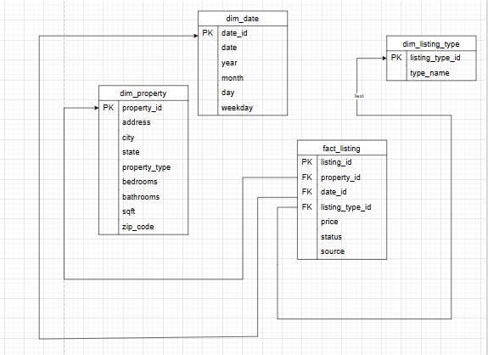
DELIVERABLES
Data Modelling for Zipco Real Estate

Slide 10
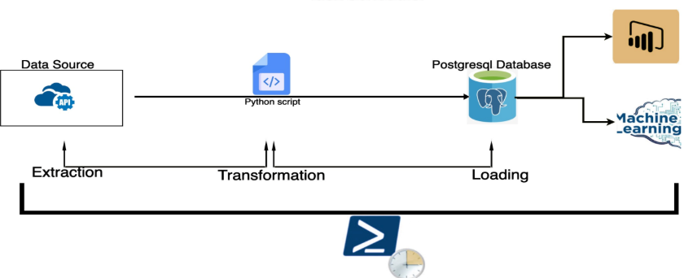
DATA ARCHITECTURE Data pipeline from API to PostGreSQL with Streamlit visualizer

Slide 11
Market Metrics Tracked
Active Sales Listings (updated on a daily basis)
01
Active Rental Listiings (updated on a daily Basis
02
Total sales listings (on state-by state basis
03
Total Rental listings (on state by state basis)
04

Slide 12
Access & Transparency Tools
Dashboards via streamlit
Query Layer for analysts and researchers
Public API or downloadable structured datasets

Slide 13
Impact
Empowers stakeholders with reliable market data
Enables long-terM trend analysis IN THE REAL ESTATE
Fosters transparency in decentralized HOUSING SYSTEM

Slide 14

Next Steps
Add
Other metrics to build more useful insights
Expand
Expand to explore other aspect in the real Estate Eco system
Integrate
Integrate anomaly detection and market alerts

Slide 15
Link to Project Resources
GitHub link
Resources
More Resources

Slide 16

Thank You
Questions & Answers

